Slide 1
Reporting in Pharma Commercial Operations
Presented By
Group 6
Ajaya Saipriya Sahoo (A8529)
Vaibhav Bhardwaj (A8530)
Sidhartha Thakur (A8531)
Unnikrishnan P (A8532)
Date: 09-Apr-2025

Slide 2

What is Reporting?
Objectives and Business Needs
Approach and Methods
Agenda

Slide 3
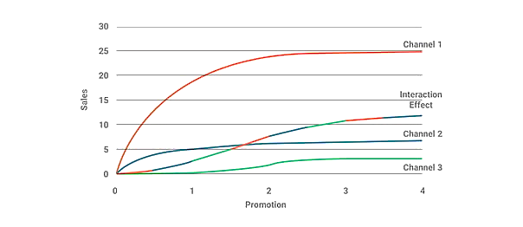



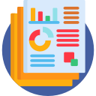


What is Reporting ?
The means and measure used to collect, process, store and present information within an organization
Sales Report
Field Report
Market Access Report
Marketing Report
Patient Insights
Compliance Report
(Market Mix Analysis of A Top US Pharma Company)¹
Types
Example
¹Source: Market Mix Modeling & Analytics for a Top US Pharma Company

Slide 4

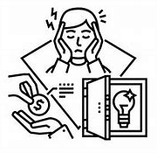

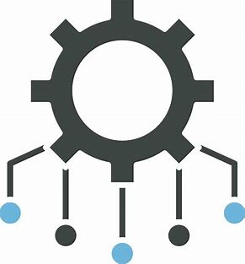
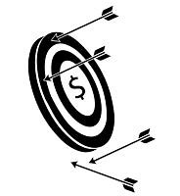

Why ? Objectives and Business Needs
Consequences of Poor Reporting
Objectives
Business Needs
Monitor Sales & Marketing Effectiveness
Track KPIs to measure performance accountability
Insufficient Resource Allocation
Ensure Compliance with Industry Regulations
Provide data-driven insights to enhance transparency
Missed Sale/ Market Opportunity
Enable Data Driven Decision making for Risk Mitigation
Enable quick response to market & competitor changes
Regulatory fines for non-compliances
Deeper understanding of the customer
Patient-Centric Strategies
Companies that have succeeded in implementing data and analytics are nearly twice as likely as others to report reaching their data and analytics objectives and nearly 1.5 times more likely to report revenue growth of at least 10 percent in the past three years. (Source: How leaders in data and analytics have pulled ahead | McKinsey)

Slide 5

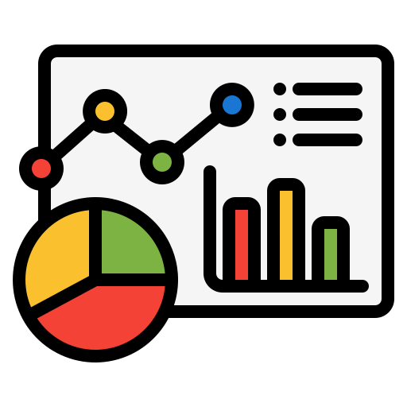
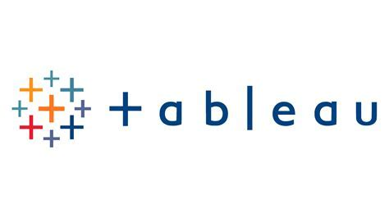
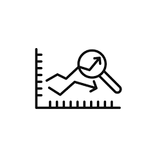


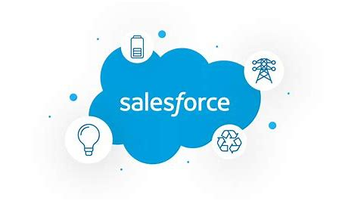



How? Approaches and Methods
Methods
Approaches
Tools
Descriptive : Analyzes past data to understand trends
Standard dashboards
for consistent reporting
Predictive : Uses historical data to forecast future outcomes
Automation Tools like Power BI for real-time insights
AI/ML : Detect patterns and enhance targeting precision
Integration of data from multiple source
Image/Icon Sources: Google Images and Flaticon

